Slide 1
Project 1 :
Investigate a Relational Database

Slide 2
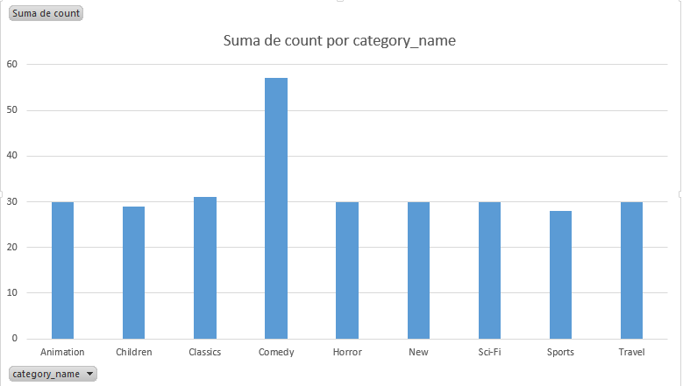
It is required to know which are the 10 most rented "G" rated movies.
You must create a query that shows by rating and movie how many times they have been rented

Slide 3
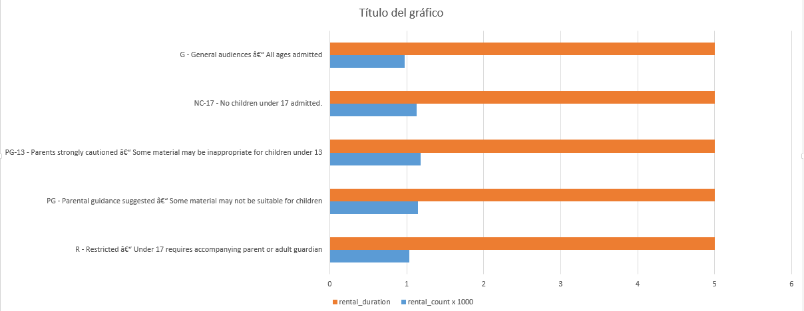
It is required to know the number of rented movies by rating and the length of rental that each one had.
Debes crear una consulta que muestre por clasificación, y promedio de la duración del alquiler

Slide 4
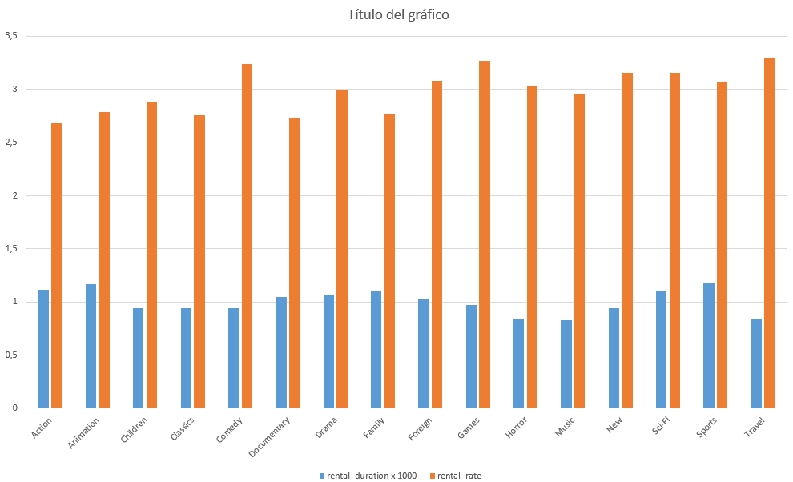
It is required to know what is the average rental time of the 10 most rented movies
This graph shows which were the most rented movies according to their rental durations

Slide 5
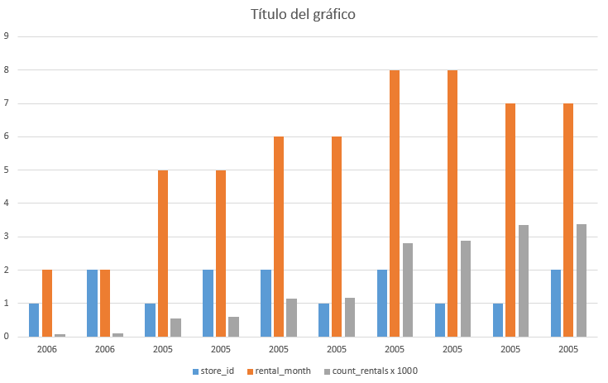
It is required to know the stores, months and years where the most movies were rented per store
A query must be created with the store id, month and year along with the number of rentals.

